Slide 1
BUS TICKET RESERVATION SYSTEM
2103A51134 - M.Akshaya
2103A51168 - k.shruthi
2103A51336 - r.deepthi
2103A51187 - t.chandana

Slide 2
PROBLEM STATEMENT: Currently, the type of system being used at the counter is an internal system which is manually used in selling the bus tickets. The problems facing the company are that customers have to go to the counter to buy bus ticket or ask for bus schedule, customers will also have to queue up for a long time in order to secure a bus ticket and will also need to pay cash when they buy the bus ticket.
contents
Introduction
Objectives
Requirements
User defined functions
Sample outputs
Conclusion
References

Slide 3
INTRODUCTION
This project presents a review on the software program “Online Bus Ticket Reservation System” as should be used in a bus transportation system, a facility which is used to reserve seats, cancellation of reservation and different types of route enquiries used on securing quick reservations.
This project titled “BUS TICKET RESERVATION SYSTEM”is design mainly for the purpose of managing all activities like:
1.Viewing bus list
2. Book Tickets
3. Cancel Booking
4.Bus Status Board

Slide 4
objectives
The major objectives of bus ticket reservation system project are:
Making reservation fast
Providing access to customers
Store data in files

Slide 5
requirements
System development hardware
CPU : Intel i5, 3.0 GHz software requirement
RAM : DDR4 8GB Dev C++
SSD : 512GB VS Code
Monitor : Color monitor
User hardware requirement
CPU : Intel Pentium 4, 2.0 GHz
RAM : DDR2 1GB
HDD : 80 GB
Monitor : Color monitor

Slide 6
User defined functions
The project on the topic bus ticket reservation system
View() : To view the buses
Book() : to book the bus
Cancel() : to can the bus ticket
Status() : it shows the status of the bus seats
Exit() : to exit from the bus reservation

Slide 7
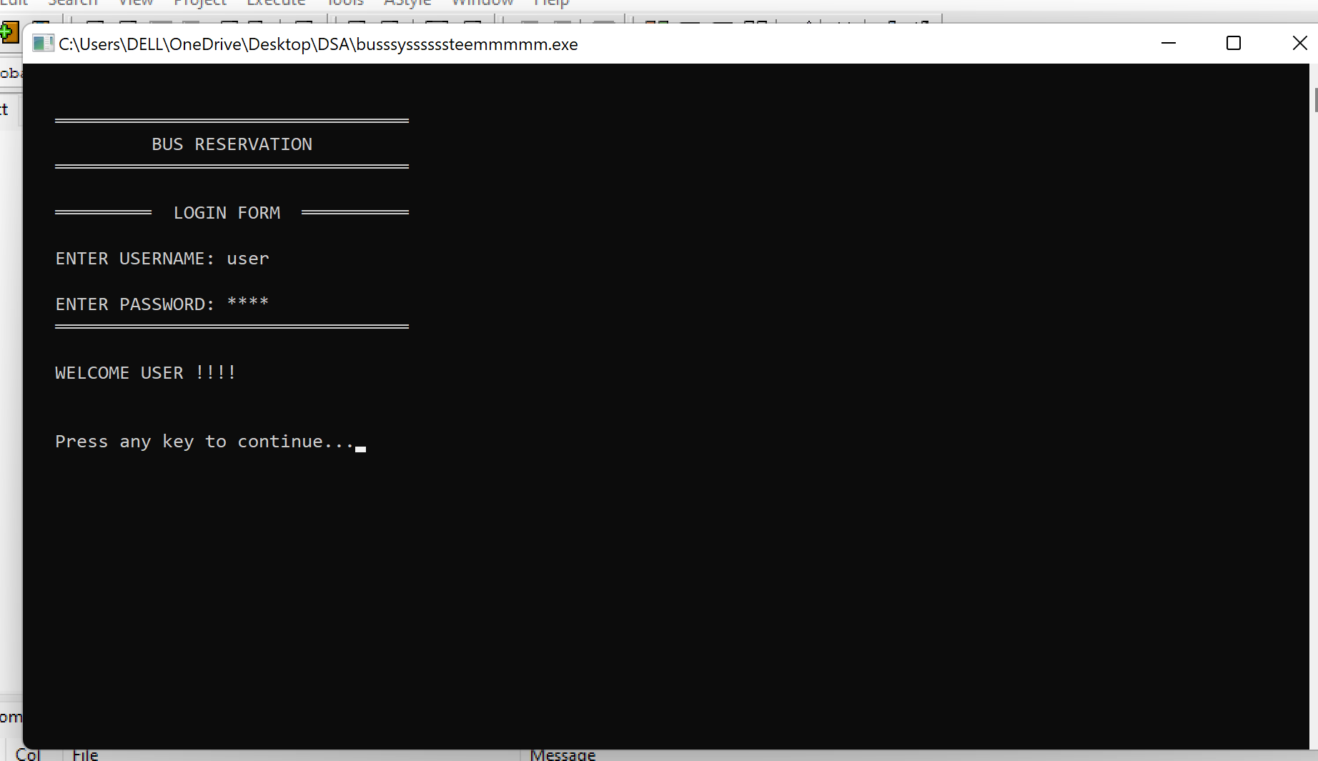
Sample outputs login page:

Slide 8
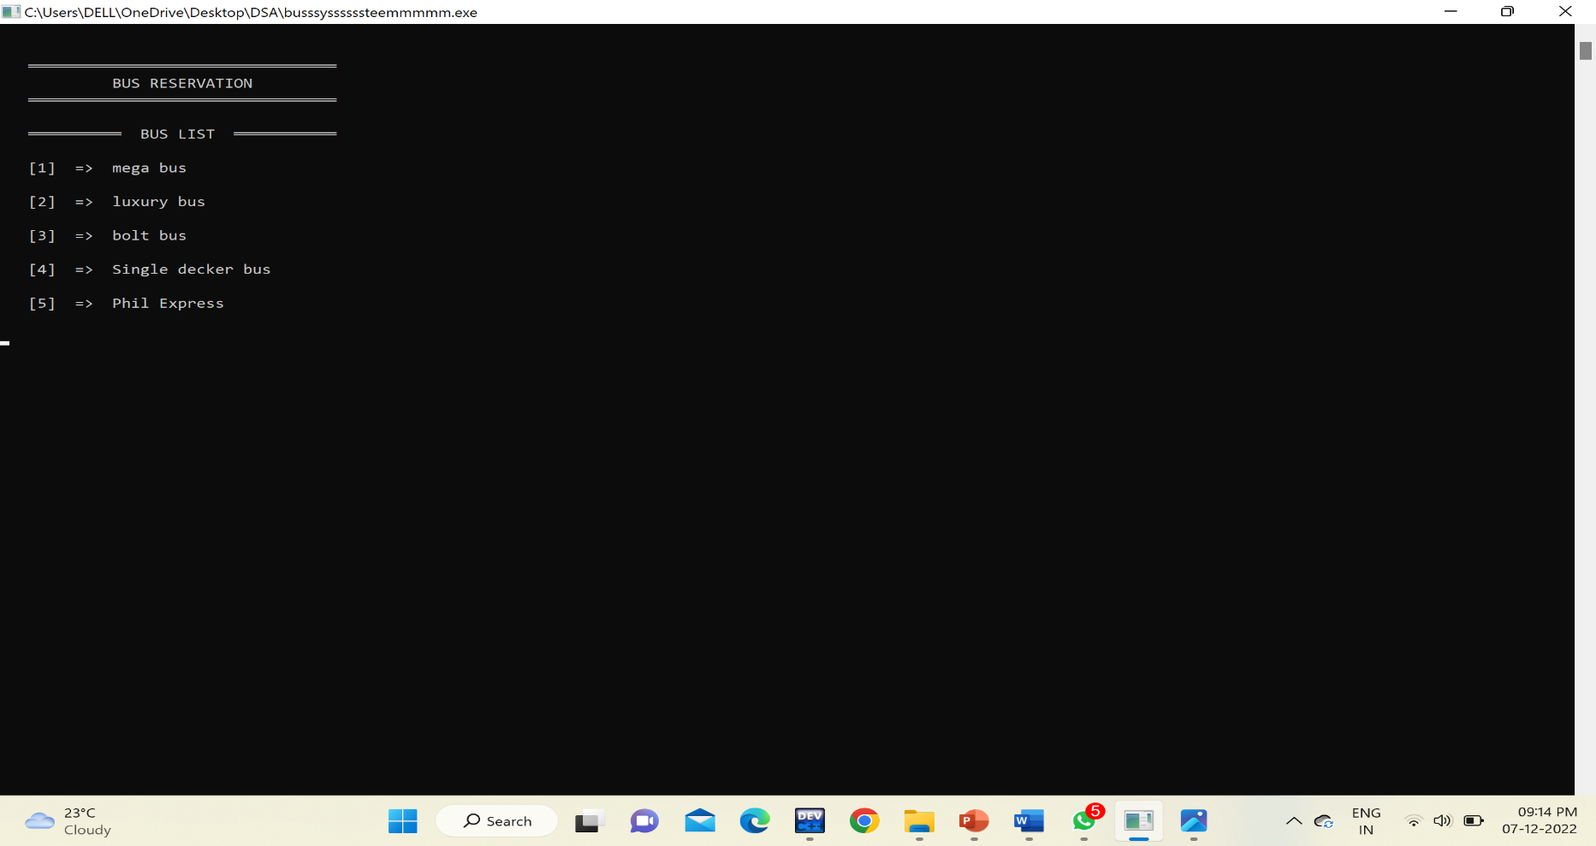
Bus list

Slide 9
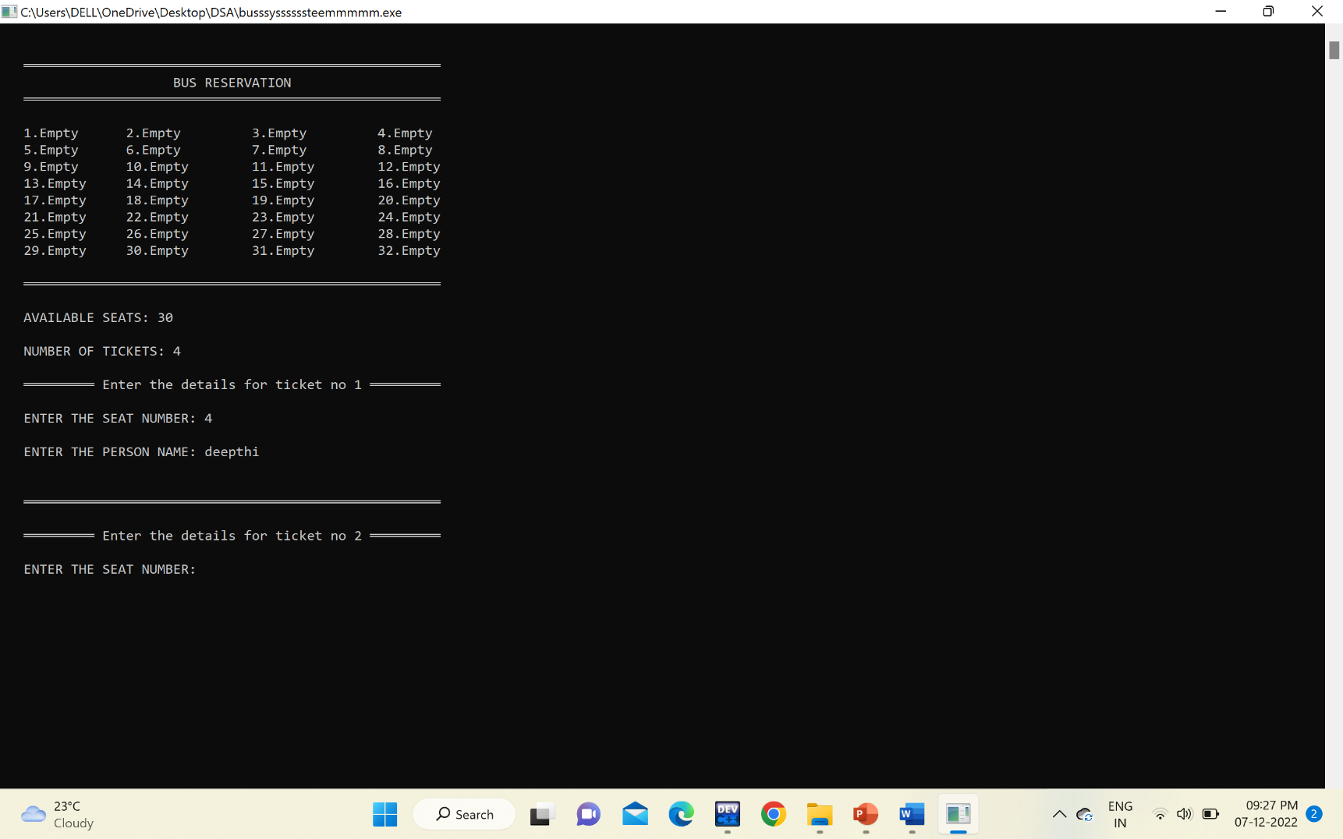
Booking seats

Slide 10
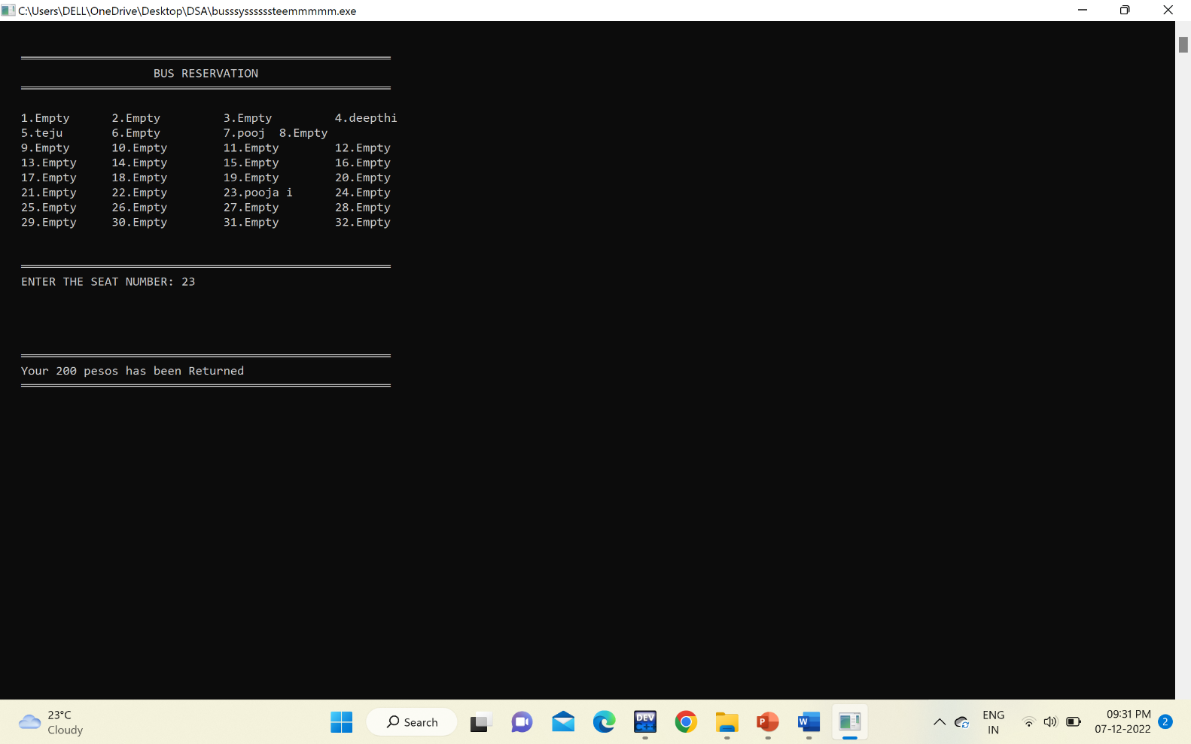
Cancelling seat

Slide 11
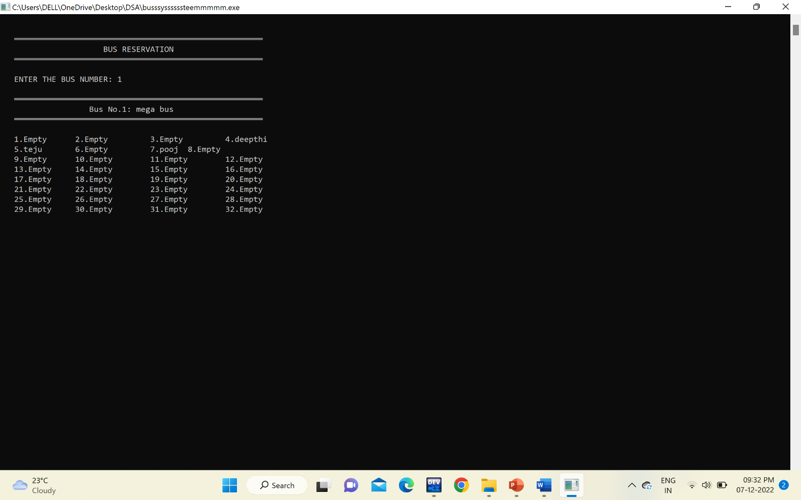
Status of bus

Slide 12
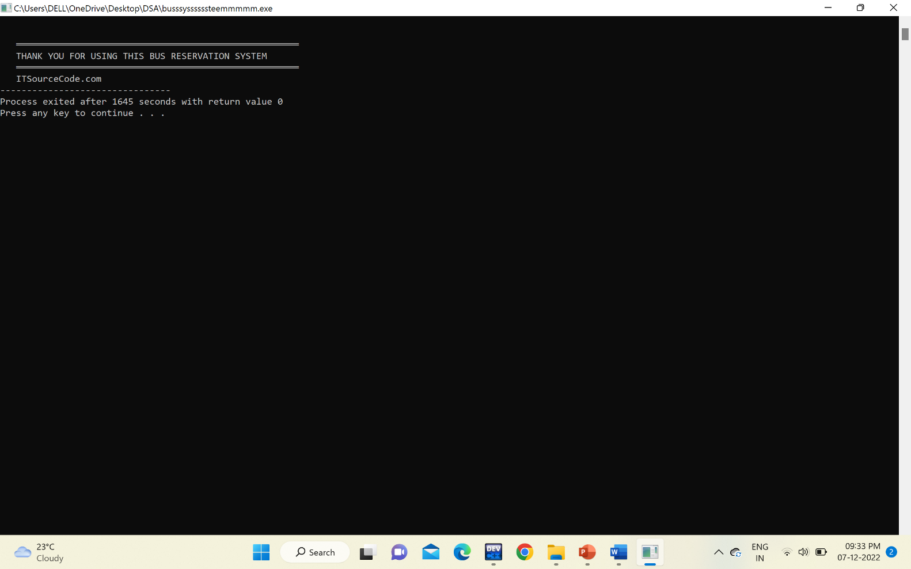
exit

Slide 13
conclusion
It can be observed that computer applications are very important in every field of human endeavor. Here all the information about customer that made reservation can be gotten just by clicking a button with this new system, some of the difficulties encountered with the manual system are overcome. It will also reduce the workload of the staff, reduce the time used for making reservation at the bus terminal and also increase efficiency. The application also has the ability to update records in various files automatically thereby relieving the company’s staff the stress of working from file security of data.

Slide 14
references
◆ https://www.geeksforgeeks.org/c-programming-language/?ref=gcse
◆ https://www.javatpoint.com/c-programming-language-tutorial
◆ https://www.mygreatlearning.com/blog/data-structures-using-c/

Slide 15
__________Thankyou__________

